Slide 1

STUDENT LOAN SYSTEM
BY -> B1-TEAM MFG01

Slide 2

Agenda
INTRODUCTION
MAIN OPTION SCREEN
LOGIN SCREEN
NEW ACCOUNT SCREEN
ACCOUNT DETAILS SCREEN
TRANSACTION SCREEN
LOADING…

Slide 3

INTRODUCTION
STUDENT LOAN SYSTEM
STUDENT LOAN SYSTEM IS A SOFTWARE WHICH IS USEFUL FOR CREATING THE NEW LOAN ACCOUNTS FOR STUDENTS BY THE EMPLOYEES AND THE STUDENTS WILL BE ABLE TO SEE THEIR ACCOUNT DETAILS AND THEIR TRANSACTION DETAILS

Slide 4

OPTION MENU SCREEN
Let’s Dive In

Slide 5
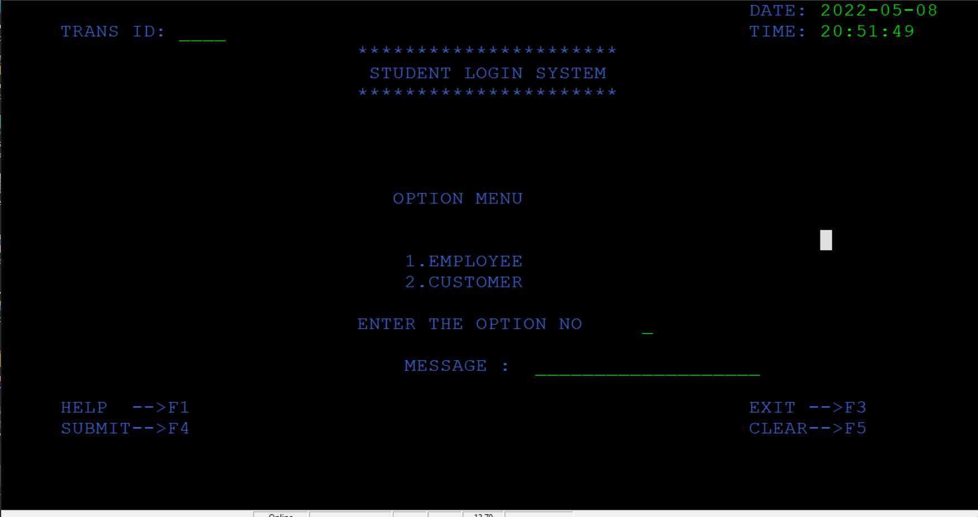
OPTION MENU
IN THIS OPTION SCREEN THE USER WILL SELECT WHETHER HE IS EMPLOYEE OR A CUSTOMER
IF THE PERSON IS AN EMPLOYEE HE WILL SELECT THE OPTION OF EMPLOYEE
IF THE PERSON IS A STUDENT HE WILL SELECT THE OPTION OF CUSTOMER

Slide 6
LOGIN SCREEN
LET’S GO

Slide 7
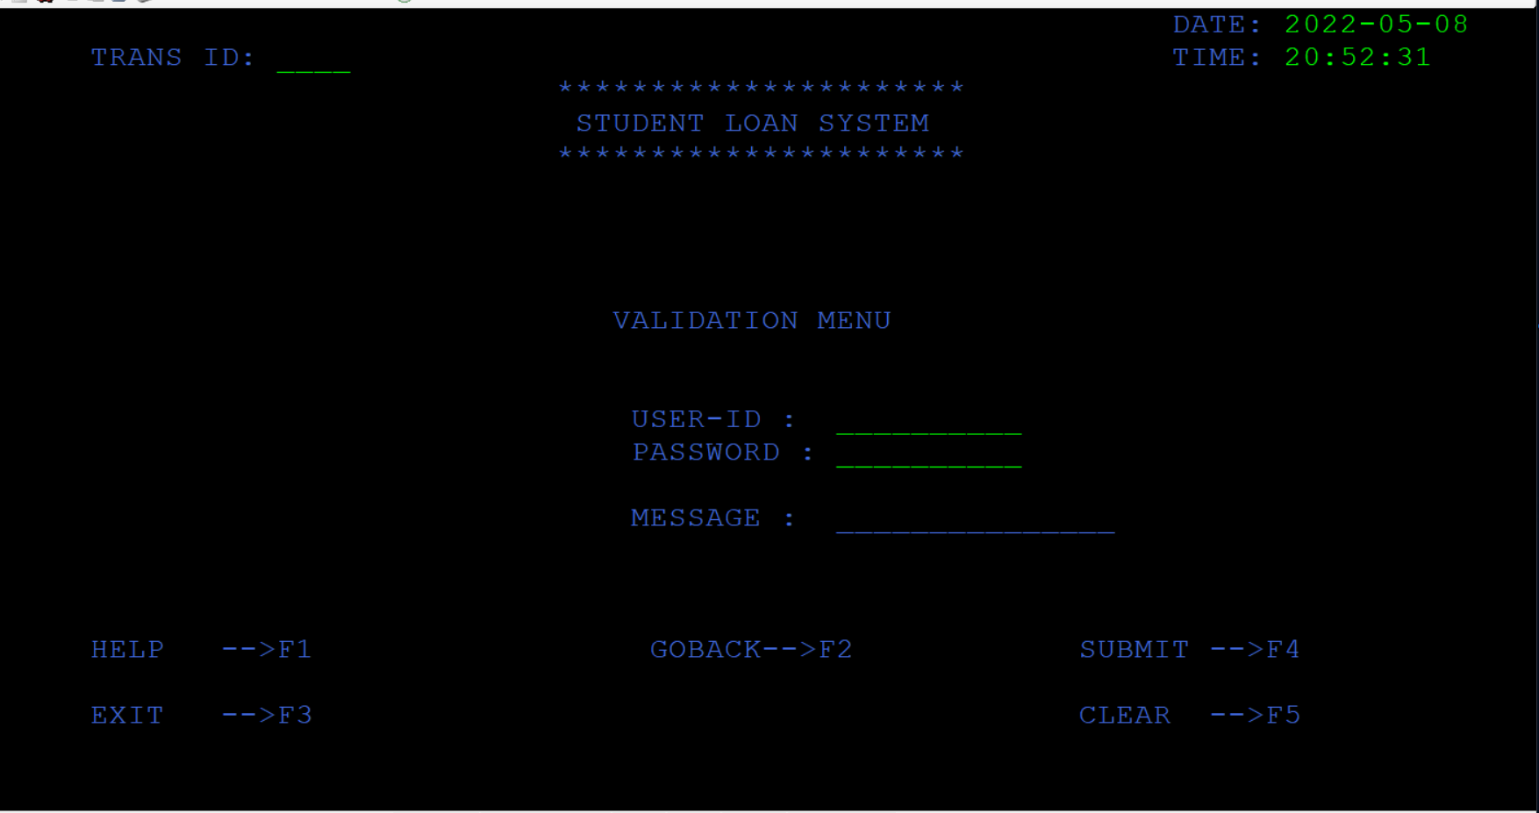
LOGIN SCREEN
AFTER SELECTING IN THE OPTIONS MENU THE USER WILL BE REDIRECTS TO THIS LOGIN PAGE
HERE USER HAS TO ENTER THE USERID AND PASSWORD OF HIS/HER TO SEE THE DETAILS

Slide 8

NEW ACCOUNT SCREEN
CREATING ACCOUNTS…

Slide 9
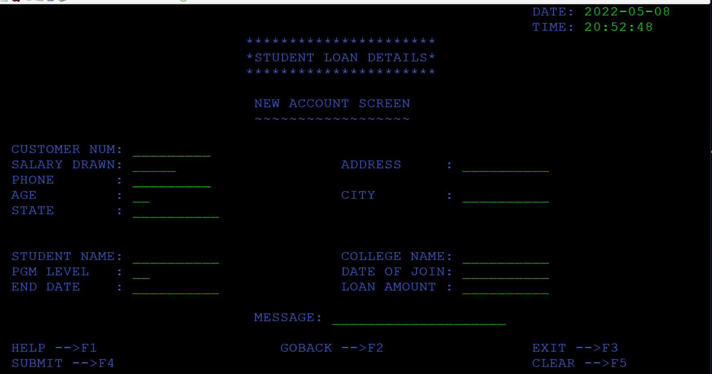
NEW ACCOUNT SCREEN
AFTER ENTERING THE USERID AND PASSWORD THE EMPLOYEE WILL BE REDIRECTED TO THE NEW ACOUNT CREATION SCREEN
IN THIS SCREEN THE EMPLOYEE WILL BE ABLE TO CREATE THE NEW LOAN ACCOUNTS FOR THE STUDENTS

Slide 10

CUSTOMER OPTION MENU
SELECTING YOUR CHOICE OF TWO OPTIONS

Slide 11
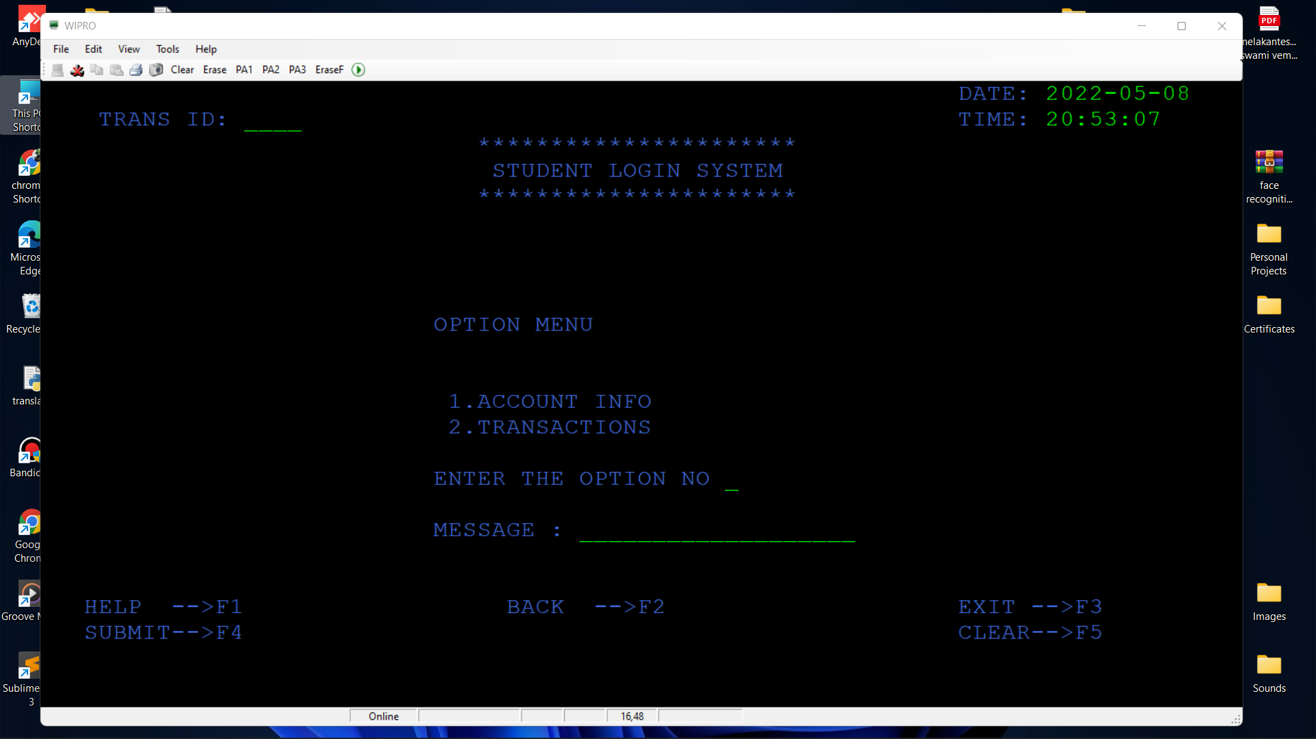
CUSTOMER OPTION MENU
AFTER ENTERING THE USERID AND PASSWORD THE STUDENT WILL BE REDIRECTED TO THE CUSTOMER OPTION SCREEN
IN THIS SCREEN THE STUDENT WILL BE ABLE TO SELECT THE OPTION TO VIEW THEIR ACCOUNT DETAILS OR TO VIEW THEIR TRANSACTION DETAILS

Slide 12
ACCOUNT SCREEN
GETTING DETAILS..

Slide 13
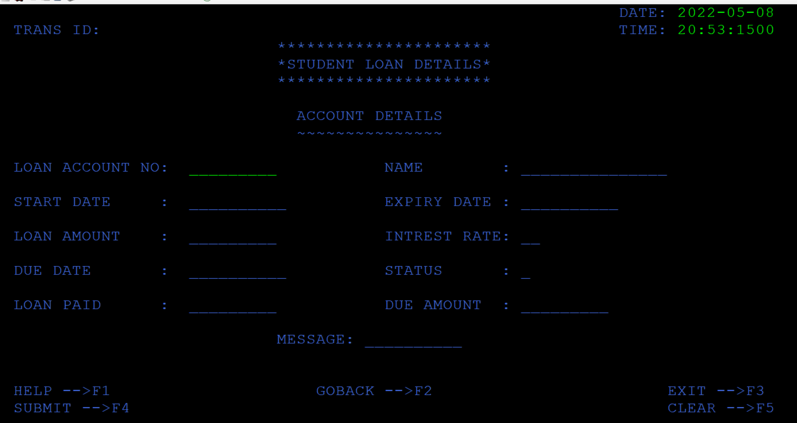
ACCOUNT DETAILS SCREEN
AFTER SELECTING THE ACCOUNT INFO OPTION THE STUDENT WILL BE REDIRECTED TO THE ACCOUNT SCREEN
IN THIS SCREEN THE STUDENT WILL BE ABLE TO FETCH THE DETAILS OF HIS ACCOUNT BY ENTERING AN ACCOUNT NUMBER

Slide 14
LOADING TRANSACTIONS…
TRANSACTONS SCREEN

Slide 15
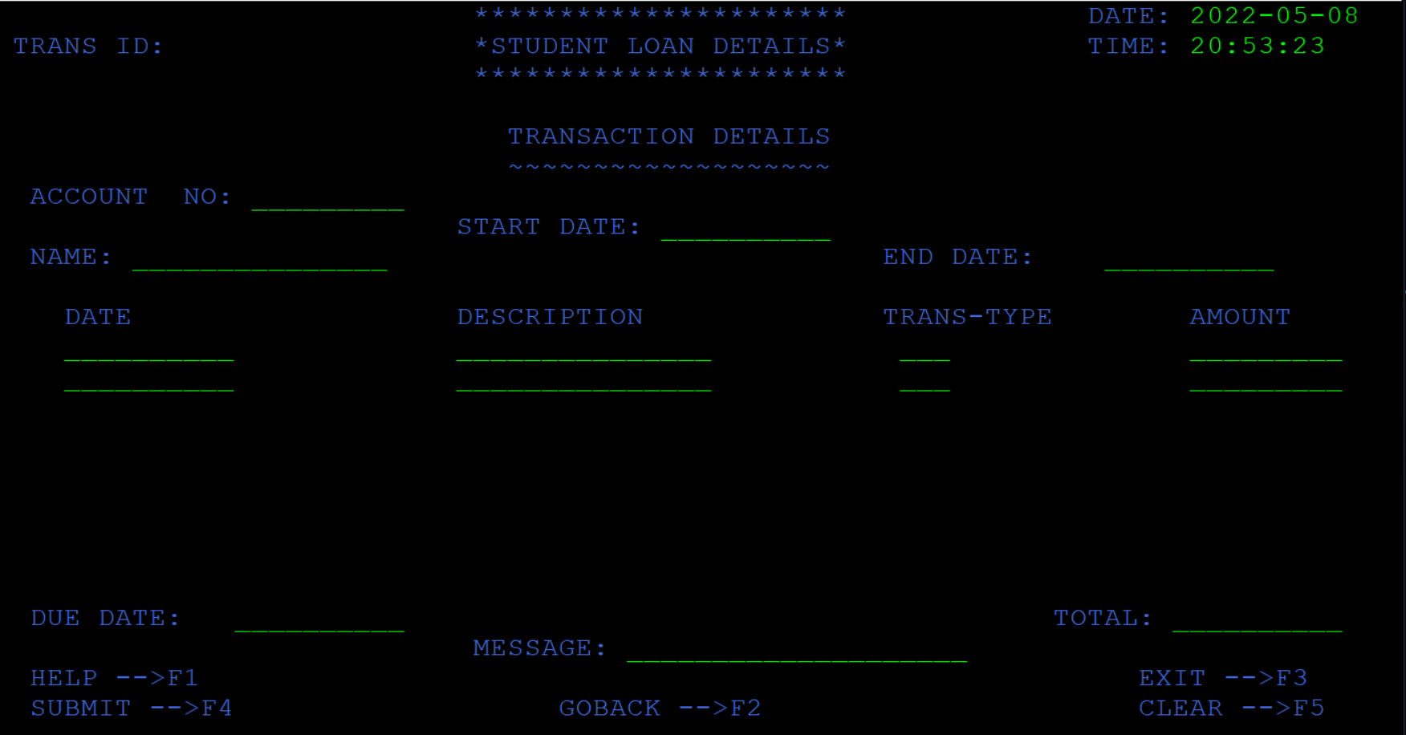
TRANSACTIONS SCREEN
AFTER SELECTING THE OPTION AS TRANSACTION DETAILS IN THE OPTION MENU HE WILL BE REDIRECTED TO THIS SCREEN
IN THIS SCREEN THE STUDENT WILL BE ABLE TO FETCH ALL HIS PAST TRANSACTIONS BY ENTERING THE ACCOUNT NUMBER AND DATE FIELDS.

Slide 16


THANK YOU
BATCH-1 MFG01 TEAM
@WIPRO.COM
THANK YOU

